Slide 1

Week # 6
Operations Research
(Software Engineering)

Slide 2
Two phase SIMPLEX method
In two phase Simplex method the whole procedure of solving a Linear programming problem involving artificial variable is divided into two phases. In Phase-I we form a new objective function by assigning negative one to each of the artificial variables (for maximization case) and multiply with positive one (for minimization case). Then we try to eliminate the artificial variables from the basis. After that all the values in new function is zero or negative for minimization problem, then we move towards phase-II and using simplex algorithm to find an optimal solution.

Slide 3

Two phase SIMPLEX method
Example 1:
$$Min Z=4x_{1}+x_{2}$$
Subject to Constraints:
$${3x}_{1}+x_{2}=3$$
$$4x_{1}+{3x}_{2}≥ 6$$
$$x_{1}+{2x}_{2}≤4$$

Slide 4
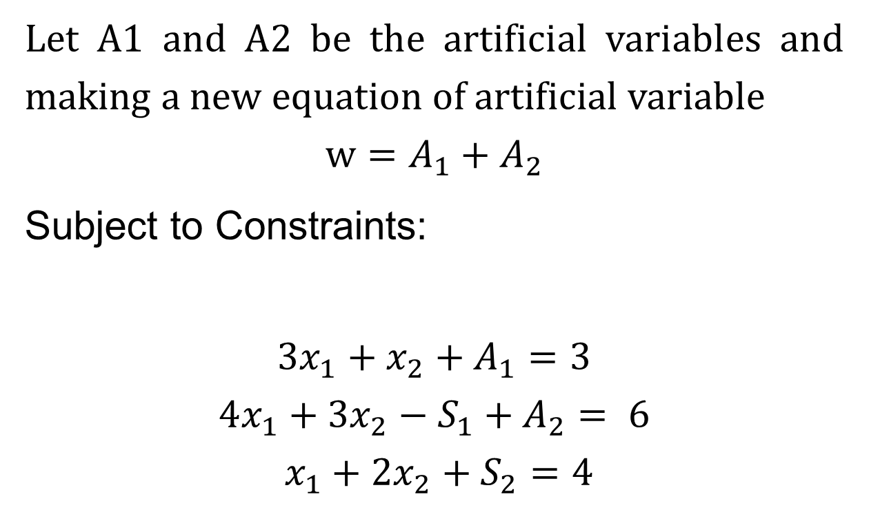
Two phase method
Let A1 and A2 be the artificial variables and making a new equation of artificial variable
$$w=A_{1}+A_{2}$$
Subject to Constraints:
$${3x}_{1}+x_{2}+A_{1}=3$$
$$4x_{1}+{3x}_{2}−S_{1}+A_{2}= 6$$
$$x_{1}+{2x}_{2}+S_{2}=4$$

Slide 5
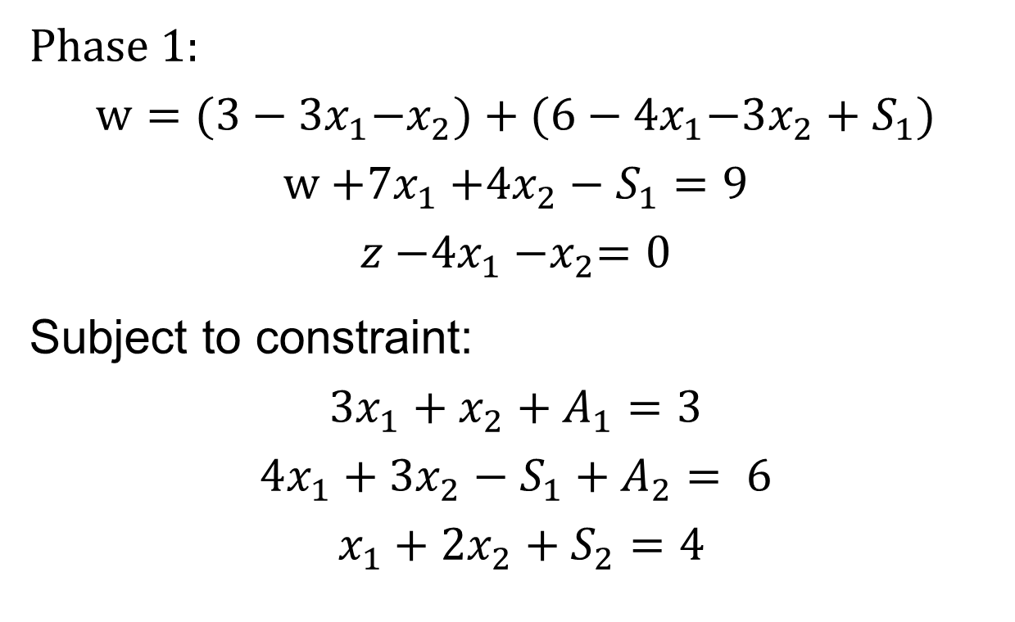
Two phase method
Phase 1:
$$w={(3−3x}_{1}−x_{2})+{(6−4x}_{1}−3x_{2}+S_{1})$$
$$w{+7x}_{1}{+4x}_{2}−S_{1}=9$$
$$z{−4x}_{1}{−x}_{2}=0$$
Subject to constraint:
$${3x}_{1}+x_{2}+A_{1}=3$$
$$4x_{1}+{3x}_{2}−S_{1}+A_{2}= 6$$
$$x_{1}+{2x}_{2}+S_{2}=4$$

Slide 6
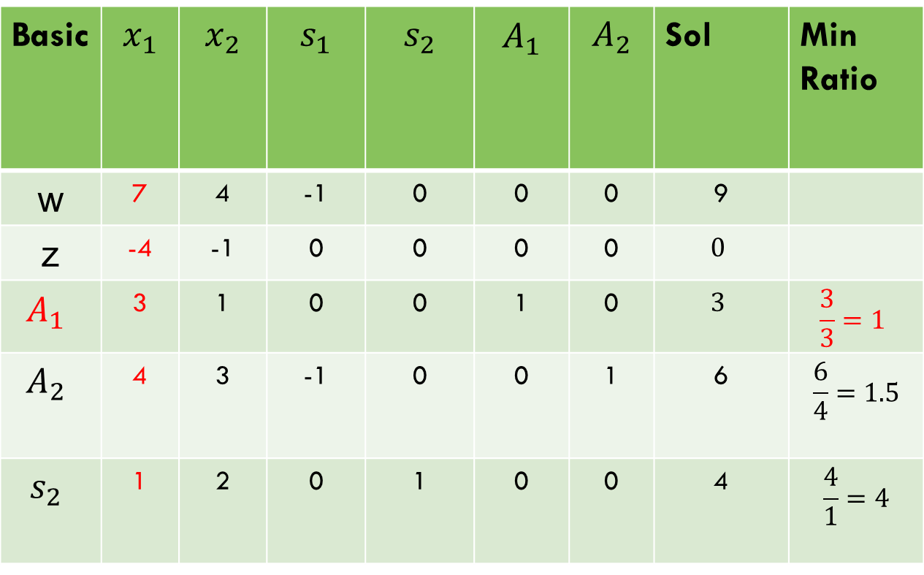
Two phase method (Minimization so choose more positive value in w-row)
Basic | $$x_{1}$$ | $$x_{2}$$ | $$s_{1}$$ | $$s_{2}$$ | $$A_{1}$$ | $$A_{2}$$ | Sol | Min Ratio
w | 7 | 4 | -1 | 0 | 0 | 0 | 9
z | -4 | -1 | 0 | 0 | 0 | 0 | $$0$$
$$A_{1}$$ | 3 | 1 | 0 | 0 | 1 | 0 | $$3$$ | $$\frac{3}{3}=1$$
$$A_{2}$$ | 4 | 3 | -1 | 0 | 0 | 1 | 6 | $$\frac{6}{4}=1.5$$
$$s_{2}$$ | 1 | 2 | 0 | 1 | 0 | 0 | 4 | $$\frac{4}{1}=4$$

Slide 7

Two phase method
Basic | $$x_{1}$$ | $$x_{2}$$ | $$s_{1}$$ | $$s_{2}$$ | $$A_{1}$$ | $$A_{2}$$ | Sol | Min Ratio
w | 7 | 4 | -1 | 0 | 0 | 0 | 9
z | -4 | -1 | 0 | 0 | 0 | 0 | $$0$$
$$x_{1}$$ | 3 | 1 | 0 | 0 | 1 | 0 | $$3$$ | $$\frac{3}{3}=1$$
$$A_{2}$$ | 4 | 3 | -1 | 0 | 0 | 1 | 6 | $$\frac{6}{4}=1.5$$
$$s_{2}$$ | 1 | 2 | 0 | 1 | 0 | 0 | 4 | $$\frac{4}{1}=4$$

Slide 8
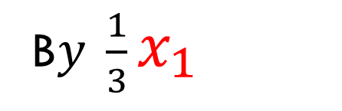
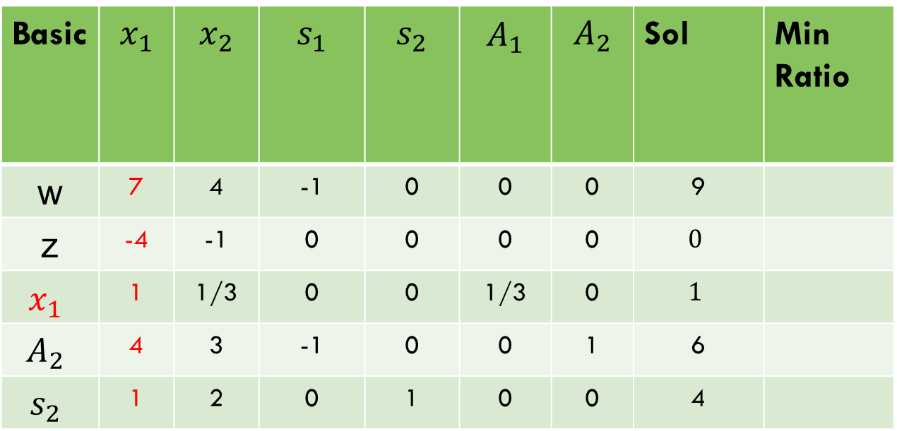
Two phase method
Basic | $$x_{1}$$ | $$x_{2}$$ | $$s_{1}$$ | $$s_{2}$$ | $$A_{1}$$ | $$A_{2}$$ | Sol | Min Ratio
w | 7 | 4 | -1 | 0 | 0 | 0 | 9
z | -4 | -1 | 0 | 0 | 0 | 0 | $$0$$
$$x_{1}$$ | 1 | 1/3 | 0 | 0 | 1/3 | 0 | $$1$$
$$A_{2}$$ | 4 | 3 | -1 | 0 | 0 | 1 | 6
$$s_{2}$$ | 1 | 2 | 0 | 1 | 0 | 0 | 4
B$y \frac{1}{3}x_{1}$

Slide 9
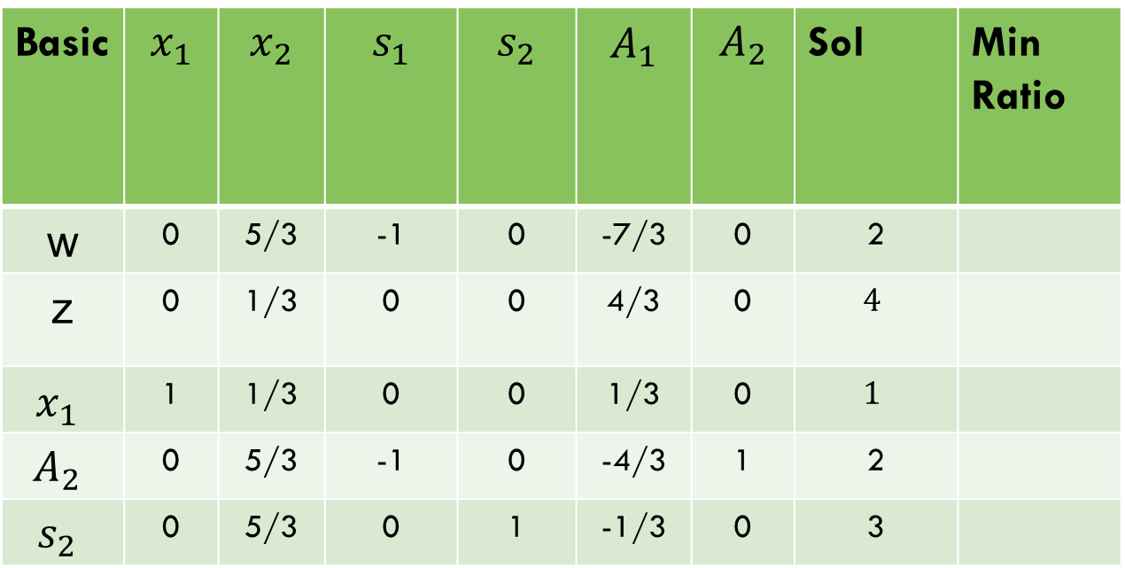





Two phase method
Basic | $$x_{1}$$ | $$x_{2}$$ | $$s_{1}$$ | $$s_{2}$$ | $$A_{1}$$ | $$A_{2}$$ | Sol | Min Ratio
w | 0 | 5/3 | -1 | 0 | -7/3 | 0 | 2
z | 0 | 1/3 | 0 | 0 | 4/3 | 0 | $$4$$
$$x_{1}$$ | 1 | 1/3 | 0 | 0 | 1/3 | 0 | $$1$$
$$A_{2}$$ | 0 | 5/3 | -1 | 0 | -4/3 | 1 | 2
$$s_{2}$$ | 0 | 5/3 | 0 | 1 | -1/3 | 0 | 3
$$w−7x_{1}$$
$$z+4x_{1}$$
$$x$$
$w−7x_{1}$,
$z+4x_{1}$,
$A2−4x_{1}$,
S2$−x_{1}$

Slide 10


Two phase method
Basic | $$x_{1}$$ | $$x_{2}$$ | $$s_{1}$$ | $$s_{2}$$ | $$A_{1}$$ | $$A_{2}$$ | Sol | Min Ratio
w | 0 | 5/3 | -1 | 0 | -7/3 | 0 | 2
z | 0 | 1/3 | 0 | 0 | 4/3 | 0 | $$4$$
$$x_{1}$$ | 1 | 1/3 | 0 | 0 | 1/3 | 0 | $$1$$ | $$3$$
$$A_{2}$$ | 0 | 5/3 | -1 | 0 | -4/3 | 1 | 2 | $$\frac{6}{5}=1.2$$
$$s_{2}$$ | 0 | 5/3 | 0 | 1 | -1/3 | 0 | 3 | $$\frac{9}{5}=1.8$$
$$w−7x_{1}$$
$$z+4x_{1}$$

Slide 11


Two phase method
Basic | $$x_{1}$$ | $$x_{2}$$ | $$s_{1}$$ | $$s_{2}$$ | $$A_{1}$$ | $$A_{2}$$ | Sol | Min Ratio
w | 0 | 5/3 | -1 | 0 | -7/3 | 0 | 2
z | 0 | 1/3 | 0 | 0 | 4/3 | 0 | $$4$$
$$x_{1}$$ | 1 | 1/3 | 0 | 0 | 1/3 | 0 | $$1$$
$$x_{2}$$ | 0 | 1 | -3/5 | 0 | -4/5 | 3/5 | 6/5
$$s_{2}$$ | 0 | 5/3 | 0 | 1 | -1/3 | 0 | 3
$$w−7x_{1}$$
$$z+4x_{1}$$
B$y \frac{3}{5}x_{2}$

Slide 12
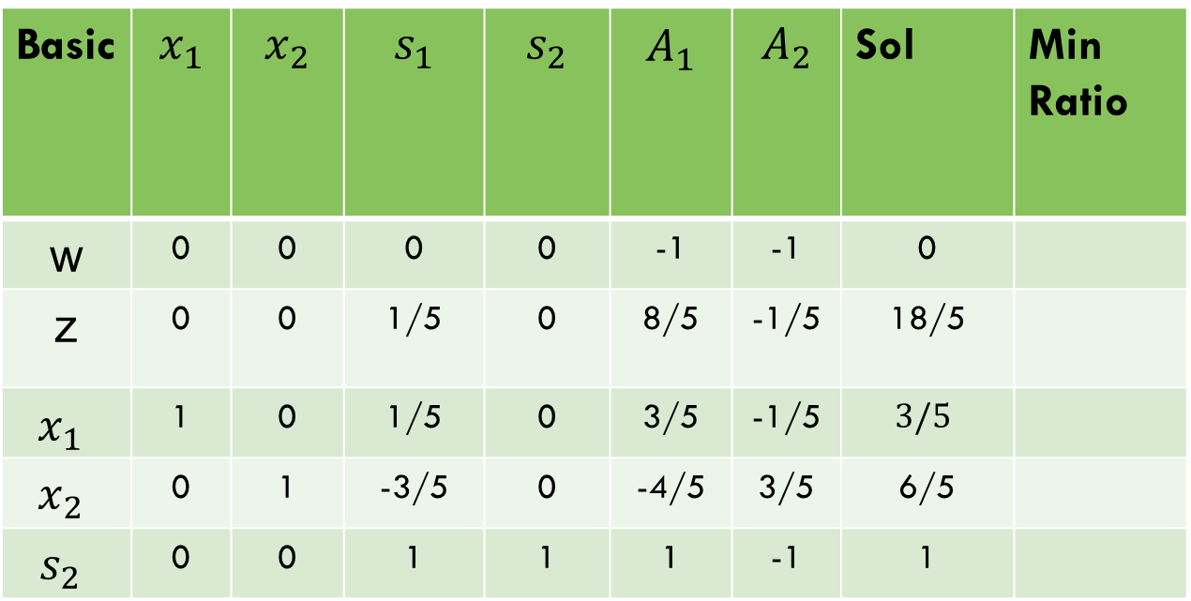




Two phase method
Basic | $$x_{1}$$ | $$x_{2}$$ | $$s_{1}$$ | $$s_{2}$$ | $$A_{1}$$ | $$A_{2}$$ | Sol | Min Ratio
w | 0 | 0 | 0 | 0 | -1 | -1 | 0
z | 0 | 0 | 1/5 | 0 | 8/5 | -1/5 | 18/5
$$x_{1}$$ | 1 | 0 | 1/5 | 0 | 3/5 | -1/5 | $$3/5$$
$$x_{2}$$ | 0 | 1 | -3/5 | 0 | -4/5 | 3/5 | 6/5
$$s_{2}$$ | 0 | 0 | 1 | 1 | 1 | -1 | 1
$$w−7x_{1}$$
$$z+4x_{1}$$
$s_{2}−\frac{5}{3}$ $x_{2}$
$x_{1}−\frac{1}{3}$ $x_{2}$
z$−\frac{1}{3}$ $x_{2}$
w$−\frac{5}{3}$ $x_{2}$

Slide 13
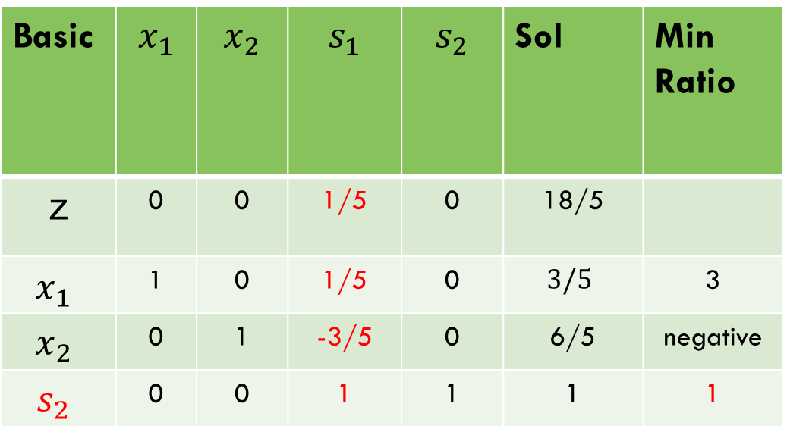

Two phase method
Phase 2. (Minimization so choose more positive value in z-row)
$$w−7x_{1}$$
$$z+4x_{1}$$
Basic | $$x_{1}$$ | $$x_{2}$$ | $$s_{1}$$ | $$s_{2}$$ | Sol | Min Ratio
z | 0 | 0 | 1/5 | 0 | 18/5
$$x_{1}$$ | 1 | 0 | 1/5 | 0 | $$3/5$$ | 3
$$x_{2}$$ | 0 | 1 | -3/5 | 0 | 6/5 | negative
$$s_{2}$$ | 0 | 0 | 1 | 1 | 1 | 1

Slide 14
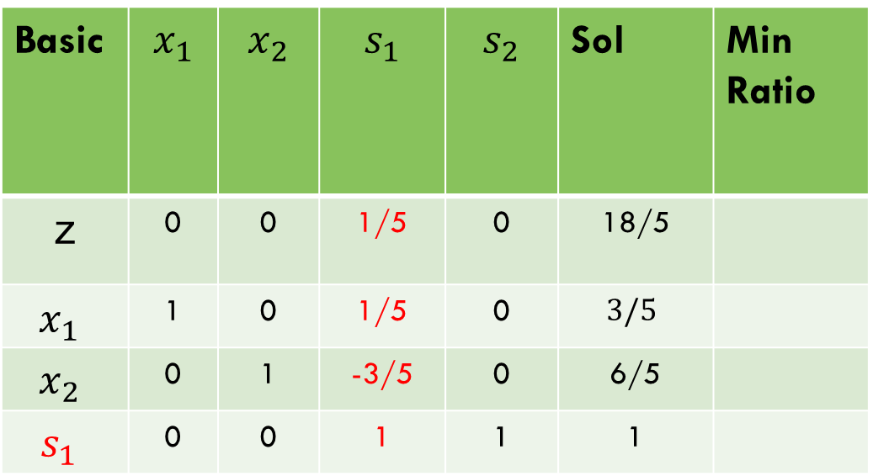

Two phase method
$$w−7x_{1}$$
$$z+4x_{1}$$
Basic | $$x_{1}$$ | $$x_{2}$$ | $$s_{1}$$ | $$s_{2}$$ | Sol | Min Ratio
z | 0 | 0 | 1/5 | 0 | 18/5
$$x_{1}$$ | 1 | 0 | 1/5 | 0 | $$3/5$$
$$x_{2}$$ | 0 | 1 | -3/5 | 0 | 6/5
$$s_{1}$$ | 0 | 0 | 1 | 1 | 1

Slide 15
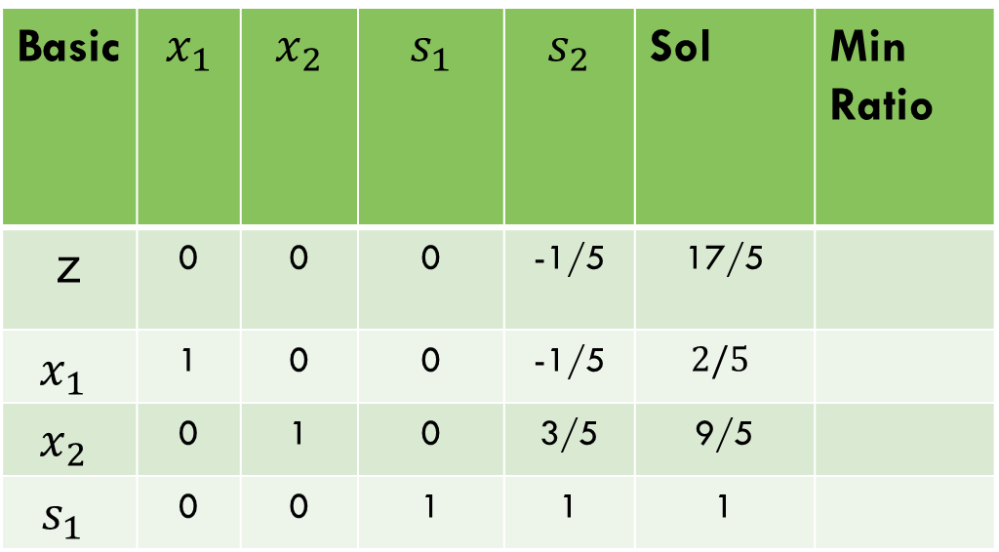



Two phase method
Basic | $$x_{1}$$ | $$x_{2}$$ | $$s_{1}$$ | $$s_{2}$$ | Sol | Min Ratio
z | 0 | 0 | 0 | -1/5 | 17/5
$$x_{1}$$ | 1 | 0 | 0 | -1/5 | $$2/5$$
$$x_{2}$$ | 0 | 1 | 0 | 3/5 | 9/5
$$s_{1}$$ | 0 | 0 | 1 | 1 | 1
$$w−7x_{1}$$
$$z+4x_{1}$$
$x_{2}+\frac{3}{5}$ $s_{1},$
$x_{1}−\frac{1}{5}$ $s_{1},$
$z−\frac{1}{5}$ $s_{1}$

Slide 16
Two phase method
Basic | $$x_{1}$$ | $$x_{2}$$ | $$s_{1}$$ | $$s_{2}$$ | Sol | Min Ratio
z | 0 | 0 | 0 | -1/5 | 17/5
$$x_{1}$$ | 1 | 0 | 0 | -1/5 | $$2/5$$
$$x_{2}$$ | 0 | 1 | 0 | 3/5 | 9/5
$$s_{1}$$ | 0 | 0 | 1 | 1 | 1
$$w−7x_{1}$$
$$z+4x_{1}$$
$$As there is no$$
$$+ve value in the objective function so the optimal solution is obtained$$

Slide 17

Two phase method
Example 2:
$$Max Z=4x_{1}+{5x}_{2}$$
Subject to Constraints:
$${2x}_{1}+3x_{2}≤6$$
$$3x_{1}+x_{2}≥3$$

Slide 18
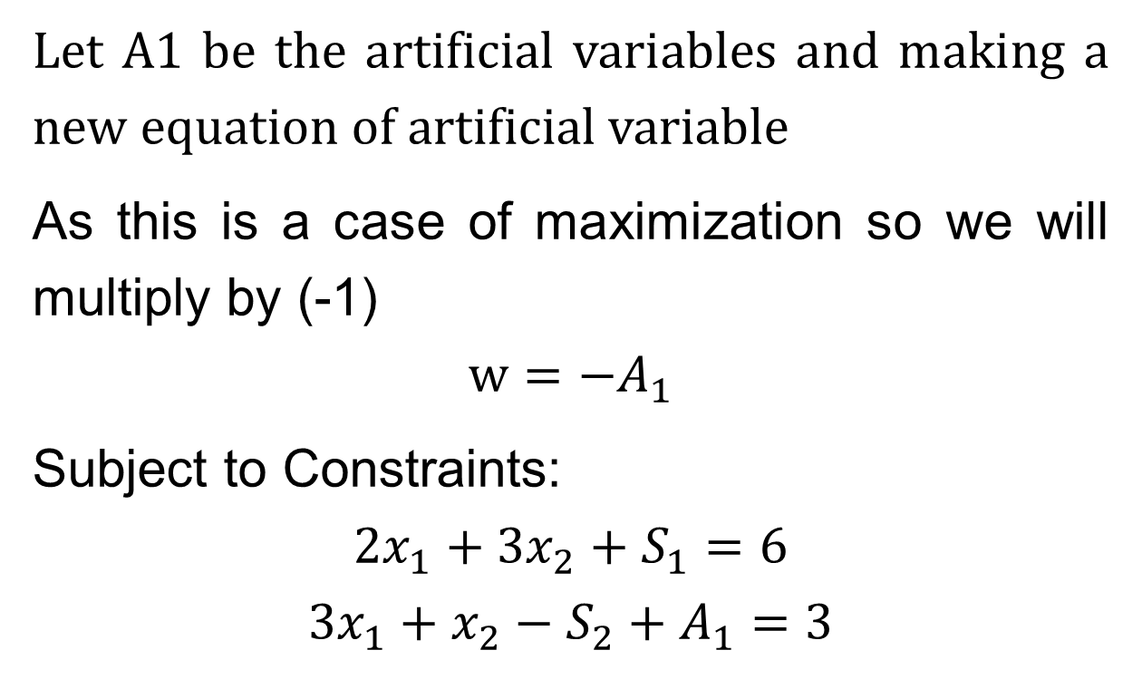
Two phase method
Let A1 be the artificial variables and making a new equation of artificial variable
As this is a case of maximization so we will multiply by (-1)
$$w={−A}_{1}$$
Subject to Constraints:
$${2x}_{1}+{3x}_{2}+S_{1}=6$$
$$3x_{1}+x_{2}−S_{2}+A_{1}=3$$

Slide 19
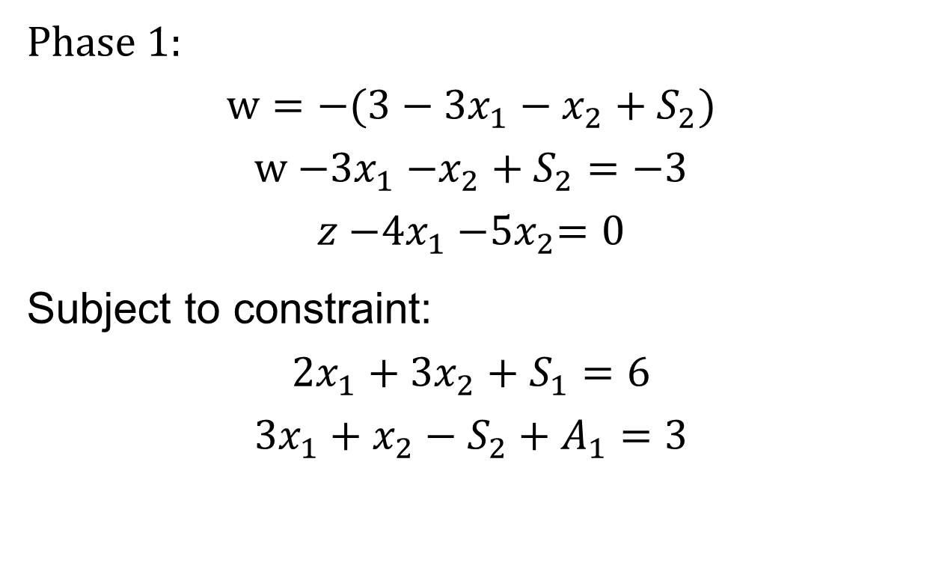
Two phase method
Phase 1:
$$w={−(3−3x}_{1}−x_{2}+S_{2})$$
$$w{−3x}_{1}{−x}_{2}+S_{2}=−3$$
$$z{−4x}_{1}{−5x}_{2}=0$$
Subject to constraint:
$${2x}_{1}+{3x}_{2}+S_{1}=6$$
$$3x_{1}+x_{2}−S_{2}+A_{1}=3$$

Slide 20
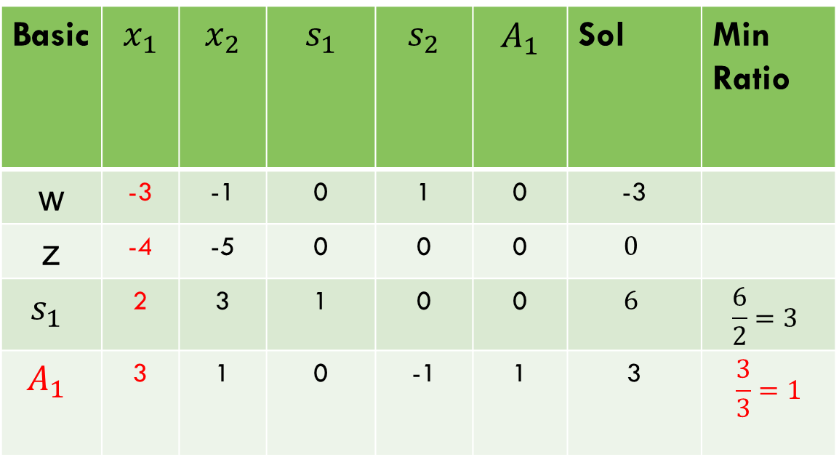
Two phase method (Maximization so choose more negative value in w-row)
Basic | $$x_{1}$$ | $$x_{2}$$ | $$s_{1}$$ | $$s_{2}$$ | $$A_{1}$$ | Sol | Min Ratio
w | -3 | -1 | 0 | 1 | 0 | -3
z | -4 | -5 | 0 | 0 | 0 | $$0$$
$$s_{1}$$ | 2 | 3 | 1 | 0 | 0 | $$6$$ | $$\frac{6}{2}=3$$
$$A_{1}$$ | 3 | 1 | 0 | -1 | 1 | 3 | $$\frac{3}{3}=1$$

Slide 21

Two phase method
Basic | $$x_{1}$$ | $$x_{2}$$ | $$s_{1}$$ | $$s_{2}$$ | $$A_{1}$$ | Sol | Min Ratio
w | -3 | -1 | 0 | 1 | 0 | -3
z | -4 | -5 | 0 | 0 | 0 | $$0$$
$$s_{1}$$ | 2 | 3 | 1 | 0 | 0 | $$6$$ | $$\frac{6}{2}=3$$
$$x_{1}$$ | 3 | 1 | 0 | -1 | 1 | 3 | $$\frac{3}{3}=1$$

Slide 22

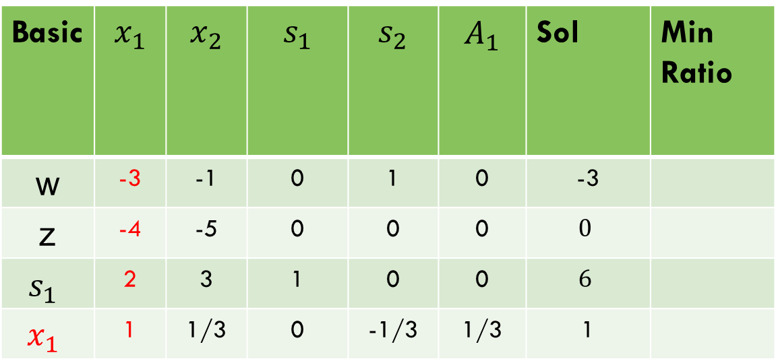
Two phase method
Basic | $$x_{1}$$ | $$x_{2}$$ | $$s_{1}$$ | $$s_{2}$$ | $$A_{1}$$ | Sol | Min Ratio
w | -3 | -1 | 0 | 1 | 0 | -3
z | -4 | -5 | 0 | 0 | 0 | $$0$$
$$s_{1}$$ | 2 | 3 | 1 | 0 | 0 | $$6$$
$$x_{1}$$ | 1 | 1/3 | 0 | -1/3 | 1/3 | 1
B$y \frac{1}{3}x_{1}$

Slide 23

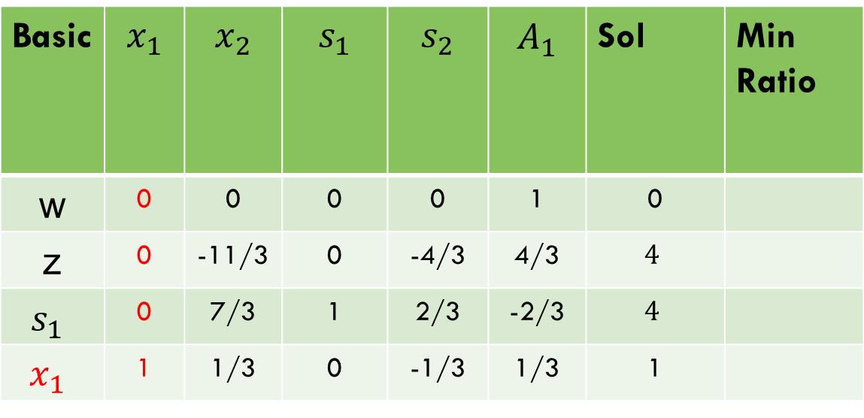


Two phase method
Basic | $$x_{1}$$ | $$x_{2}$$ | $$s_{1}$$ | $$s_{2}$$ | $$A_{1}$$ | Sol | Min Ratio
w | 0 | 0 | 0 | 0 | 1 | 0
z | 0 | -11/3 | 0 | -4/3 | 4/3 | $$4$$
$$s_{1}$$ | 0 | 7/3 | 1 | 2/3 | -2/3 | $$4$$
$$x_{1}$$ | 1 | 1/3 | 0 | -1/3 | 1/3 | 1
$s_{1}−2x_{1}$,
z$+4x_{1}$,
$w+3x_{1}$,

Slide 24
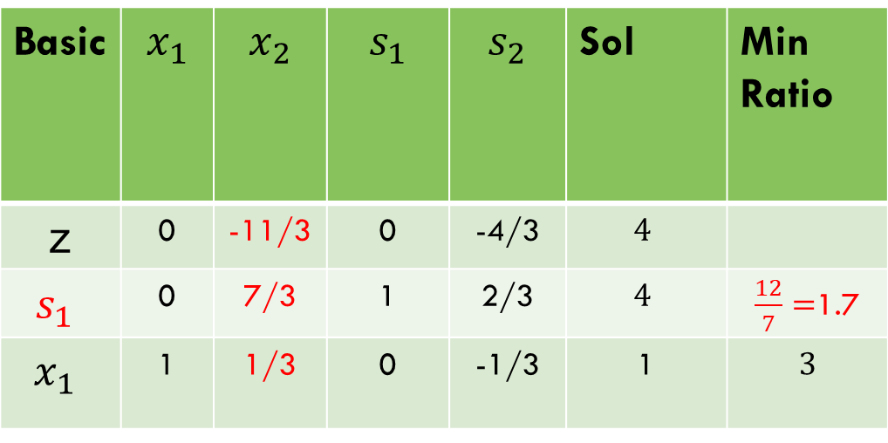
Two phase method
Phase 2. (Maximization so choose more negative value in z-row)
Basic | $$x_{1}$$ | $$x_{2}$$ | $$s_{1}$$ | $$s_{2}$$ | Sol | Min Ratio
z | 0 | -11/3 | 0 | -4/3 | $$4$$
$$s_{1}$$ | 0 | 7/3 | 1 | 2/3 | $$4$$ | $\frac{12}{7}=$1.7
$$x_{1}$$ | 1 | 1/3 | 0 | -1/3 | 1 | $$3$$

Slide 25
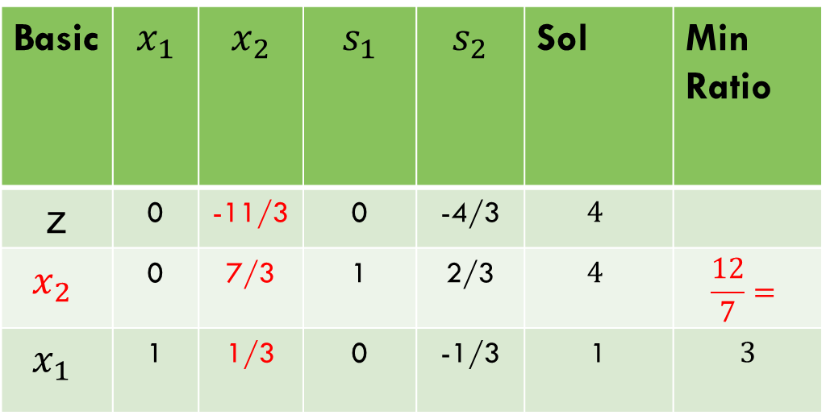
Two phase method
Phase 2.
Basic | $$x_{1}$$ | $$x_{2}$$ | $$s_{1}$$ | $$s_{2}$$ | Sol | Min Ratio
z | 0 | -11/3 | 0 | -4/3 | $$4$$
$$x_{2}$$ | 0 | 7/3 | 1 | 2/3 | $$4$$ | $$\frac{12}{7}=$$
$$x_{1}$$ | 1 | 1/3 | 0 | -1/3 | 1 | $$3$$

Slide 26

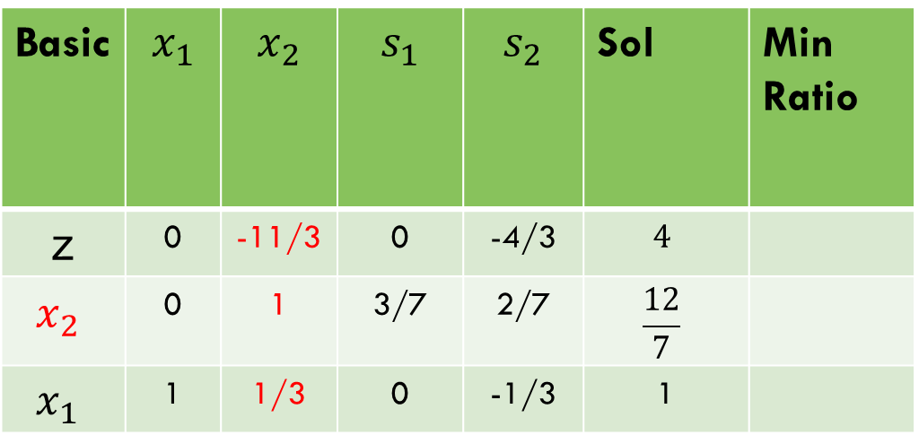
Two phase method
Basic | $$x_{1}$$ | $$x_{2}$$ | $$s_{1}$$ | $$s_{2}$$ | Sol | Min Ratio
z | 0 | -11/3 | 0 | -4/3 | $$4$$
$$x_{2}$$ | 0 | 1 | 3/7 | 2/7 | $$\frac{12}{7}$$
$$x_{1}$$ | 1 | 1/3 | 0 | -1/3 | 1
$By \frac{3}{7}$ $x_{2}$

Slide 27



Two phase method
Basic | $$x_{1}$$ | $$x_{2}$$ | $$s_{1}$$ | $$s_{2}$$ | Sol | Min Ratio
z | 0 | 0 | 11/7 | -2/7 | $$\frac{72}{7}$$
$$x_{2}$$ | 0 | 1 | 3/7 | 2/7 | $$\frac{12}{7}$$
$$x_{1}$$ | 1 | 0 | -1/7 | -3/7 | 3/7
$x_{1}−\frac{1}{3}$ $x_{2} ,$
z$+\frac{11}{3}$ $x_{2}$

Slide 28
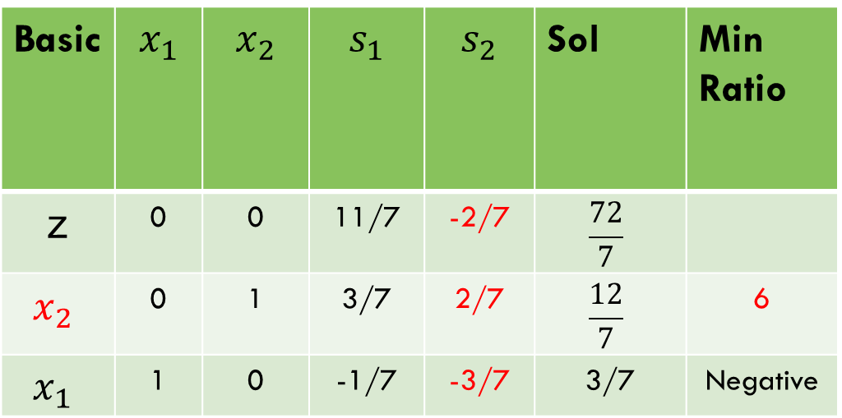
Two phase method
Basic | $$x_{1}$$ | $$x_{2}$$ | $$s_{1}$$ | $$s_{2}$$ | Sol | Min Ratio
z | 0 | 0 | 11/7 | -2/7 | $$\frac{72}{7}$$
$$x_{2}$$ | 0 | 1 | 3/7 | 2/7 | $$\frac{12}{7}$$ | 6
$$x_{1}$$ | 1 | 0 | -1/7 | -3/7 | 3/7 | Negative

Slide 29
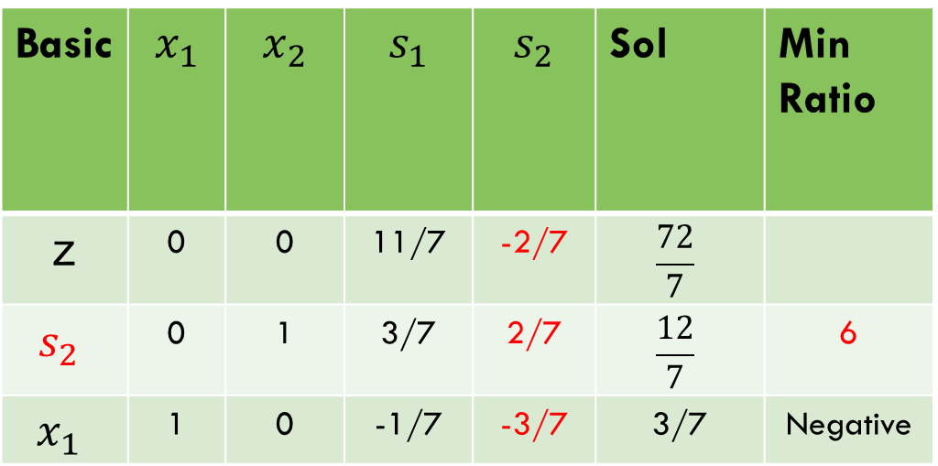
Two phase method
Basic | $$x_{1}$$ | $$x_{2}$$ | $$s_{1}$$ | $$s_{2}$$ | Sol | Min Ratio
z | 0 | 0 | 11/7 | -2/7 | $$\frac{72}{7}$$
$$s_{2}$$ | 0 | 1 | 3/7 | 2/7 | $$\frac{12}{7}$$ | 6
$$x_{1}$$ | 1 | 0 | -1/7 | -3/7 | 3/7 | Negative

Slide 30

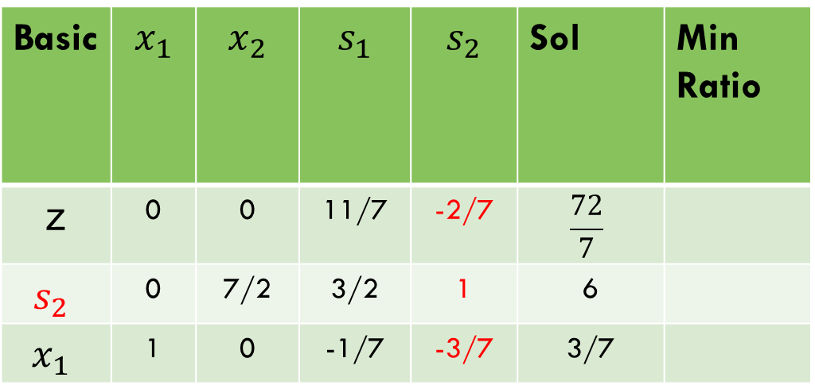
Two phase method
Basic | $$x_{1}$$ | $$x_{2}$$ | $$s_{1}$$ | $$s_{2}$$ | Sol | Min Ratio
z | 0 | 0 | 11/7 | -2/7 | $$\frac{72}{7}$$
$$s_{2}$$ | 0 | 7/2 | 3/2 | 1 | 6
$$x_{1}$$ | 1 | 0 | -1/7 | -3/7 | 3/7
$By \frac{7}{2}$ $s_{2},$

Slide 31

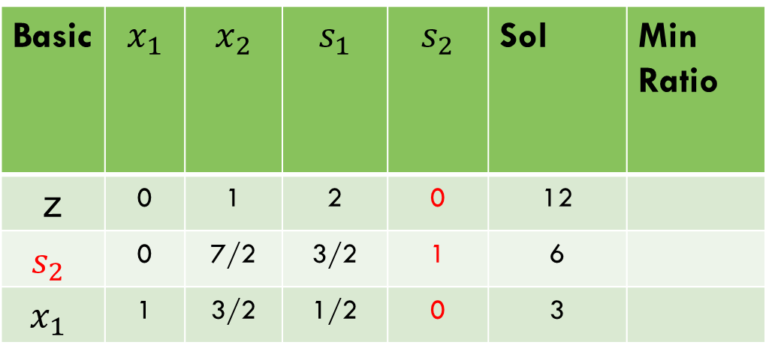

Two phase method
Basic | $$x_{1}$$ | $$x_{2}$$ | $$s_{1}$$ | $$s_{2}$$ | Sol | Min Ratio
z | 0 | 1 | 2 | 0 | 12
$$s_{2}$$ | 0 | 7/2 | 3/2 | 1 | 6
$$x_{1}$$ | 1 | 3/2 | 1/2 | 0 | 3
$x_{1}+\frac{3}{7}$ $s_{2} ,$
z$+\frac{2}{7}$ $s_{2}$

Slide 32
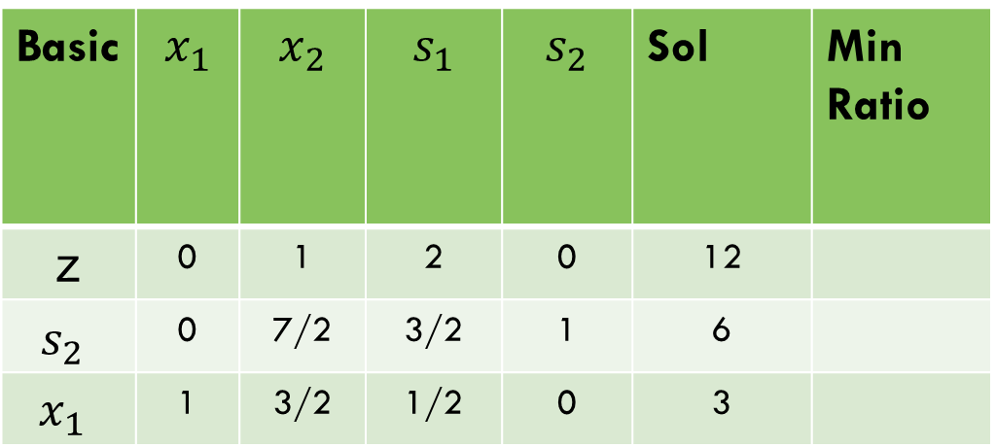
Two phase method
Basic | $$x_{1}$$ | $$x_{2}$$ | $$s_{1}$$ | $$s_{2}$$ | Sol | Min Ratio
z | 0 | 1 | 2 | 0 | 12
$$s_{2}$$ | 0 | 7/2 | 3/2 | 1 | 6
$$x_{1}$$ | 1 | 3/2 | 1/2 | 0 | 3
$$As there is no$$
$$−ve value in the objective function so the optimal solution is obtained$$

Slide 33

task
$$Max Z=5x_{1}+8x_{2}$$
Subject to Constraints:
$${3x}_{1}+{2x}_{2}≥3$$
$$x_{1}+{4x}_{2}≥4$$
$$x_{1}+x_{2}≤5$$

Slide 34
Thank you!

